Slide 1

Establishing a Value-Driven Model for Healthcare

Slide 2
Proposal
Introduce a new approach for measuring the value of healthcare (using a patient-driven model)
To provide a unified vision for delivering sustainable value for patients, practitioners, and providers.
To drive innovation & collaboration.
To guide continuous improvement (quality and efficiency) across the continuum of care

Slide 3



The Vision
Value
Quality
Practitioner-Driven
Results
Provider-Driven
Patient-Driven
“Health care organizations are increasingly concerned with looking beyond financial performance measures, while focusing on how to deliver higher quality care “
- Love, Dianne, Revere, Lee, and Black, Ken. (2008), Journal of Health Care Finance

Slide 4
Needs of the Patients
To have affordable healthcare.
To have attainable healthcare.
To have more accessible healthcare.
To have consistent levels of quality (results).
To receive a total healthcare experience:
Ensure their functional outcomes are met.
Ensure their emotional outcomes are met.
Ensure their spiritual outcomes are met.
Ensure their outcomes are met across the continuum of care (hospital, clinics, home, and nursing care).
“We continue to pay for lots of medical procedures that don't add to health value and in fact just add costs to the system..”
- Kathleen Sebelius

Slide 5
Needs of the Practitioners
To improve diagnostic capabilities in a cost-effective manner.
To improve clinical processes.
To provide consistent levels of quality.
To move beyond service, where they can deliver a positive experience.
To be able to reliably measure value for their patients, for themselves as individual practitioners , and for the providers.

Slide 6
Needs of the Providers
To get alignment amongst the hospitals, nursing homes, and home care providers on measuring value from a patient perspective.
To increase collaboration NOT competition.
To understand how to identify, measure and deliver value as patients flow through the continuum of care.
To help reduce the overall costs of healthcare while improving the overall value for patients and practitioners (where value is created).

Slide 7
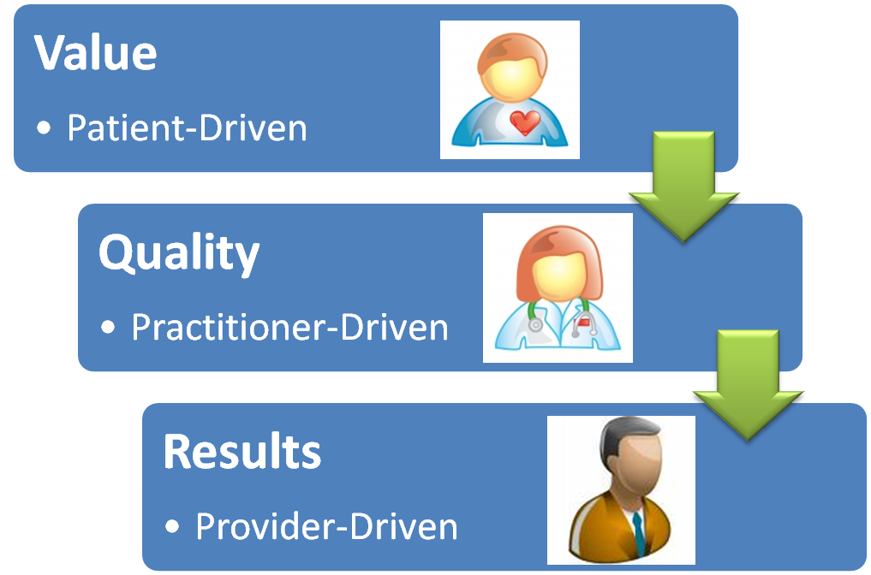

Value-Driven Healthcare Model
Providing Patients with a way to measure the value they should be receiving for healthcare throughout the continuum
Guiding Practitioners to measure and optimize the value they deliver to Patients
Guiding the Providers to deliver value to Patients & Practitioners

Slide 8
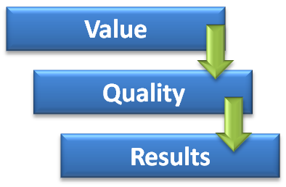
Moving from Assumptions to Implementation
Establish a program focused on mapping the Jobs & Outcomes across the healthcare domain.
Build a portfolio of unmet needs (opportunities) for improving value delivery to patients and practitioners.
Establish a prioritization model to direct resources in an efficient manner.
Create an open innovation framework using the opportunities to generate ideas that can address the most important (prioritized) unmet needs.
Align healthcare measurements (Quality = TQM, Evidence-Based = EBM) with value-driven measurements (VDM) to align information and optimize continuous improvement.

Slide 9
Measuring Value for Healthcare
Build a portfolio of jobs & outcomes:
For measuring value *
For driving innovation
For directing efforts to improve quality
For guiding initiatives to reduce cost
* Value is created between the Patient & Practitioner

Slide 10
Enabling Value for Healthcare
Value-Driven Healthcare Platform
Technology
Ideas
Resources
Innovation
Value Measurement
New Concepts
New Products & Services
New Value Delivery
Outcomes
Compliance
Quality & Efficiency
Value-Driven metrics are used to drive innovation & direct Quality & Efficiency

Slide 11
Future Opportunities
A program focused on mapping the Jobs & Outcomes across the healthcare domain.
A portfolio of unmet needs (opportunities) for improving value delivery to patients and practitioners.
A prioritization model to direct resources in an efficient manner.
An open innovation framework using the opportunities to generate ideas that can address the most important (prioritized) unmet needs.
A shared revenue model as part of a collaborative to address unmet needs.

Slide 12
Project Overview

Slide 13
Project Charter
Project Charter | Identify opportunities to improve value delivered to patients.
Project Number | Hospital - 001 | Charter Date | (TBD)
Project Sponsor | Hospital Leadership | Project Director | Jeffrey Wallk
Project Scope | Capturing patient-centric outcomes using the Value Driven Measurement (VDM) methodology to identify opportunities to improve existing products & services delivered by Hospital and its member organizations for a job that patients are trying to get done.
Deliverables | Job Study (used to select scope for the study) Job Reference Model for identifying customer outcomes and metrics for measuring value Qualitative Analysis (Interview Plan) Qualitative Analysis (Desired Outcomes) Quantitative Analysis (Survey Model) Quantitative Analysis (Value Measurements) Presentation with Recommendations
Timeline | Project Breakdown 3-4 weeks of planning 4-8 weeks of execution Qualitative study Quantitative study 1 week of presentation & review Note: Exact timelines may vary based on availability of patients during the study

Slide 14
Methodology (Planning)
Definition
Model a Job (reference model)
Model the Domain
Model the Job Ontology w/in the Domain
Location
Identify the sub-domain to study
Select the Job(s) w/in the sub-domain to study
Preparation
Interview SMEs who have or do currently execute the job
Draft the Job Reference Model for this instance (particular job)
Confirmation
Review the Domain Model
Review the Job Ontology Model
Review the Job Reference Model for this instance with SMEs
Obtain feedback and iterate the above artifacts

Slide 15
Methodology (Execution)
Execution (includes iterations of Monitoring & Modification)
Qualitative Study (Phase 1)
Interview designated job executors
Capture notes from meetings
Capture notes from observations
Transform notes into desired outcomes
Data Profiling, Cleansing, and Quality
Verify Cleansed Listing of Desired Outcomes

Slide 16
Methodology (Execution)
Execution (includes iterations of Monitoring & Modification)
Quantitative Study (Phase 2)
Prepare a survey
Prepare profiling questions
Provide script for survey executor to read
Prepare separate surveys using the desired outcomes
Targeted to specific job executors
Tailored for limited scope to reduce impacts from fatigue
Capture 2 key metrics for each desired outcome (importance & satisfaction)
Identify sample list of survey candidates (job executors)
Conduct Survey
Ideally, should be 3rd party but must be done with anonymity
Must capture profiling information
Must be able to conduct survey over phone, electronically or via written response
Data Cleansing
Data Analysis (per Core Functional Job)

Slide 17
Methodology (Presentation)
Conclusion
Thematic extraction from above analysis
Focus only on the patterns impacting desired outcomes w/ highest opportunity
Presentation of findings to the steering committee

Slide 18
Program Governance
Hospital
Sr. Leadership
Steering Committee
Project Lead
Team

Slide 19
Staffing Plan
Steering Committee
Leadership
Physician *
Nurse (LPN) *
Pharmacist *
* Part of an Advisory Board
Hospital Sr. Leadership Team
Project Team
Jeff Wallk (Lead)
Patient Advocate (2)
Nurse Practitioner

Slide 20
Key Milestones & Deliverables
Qualitative Phase:
Job Study for Project Scope
Prioritize the jobs to study
Develop an interview plan
Conduct interviews (capture outcomes)
Analyze outcomes & complete analysis
Quantitative Phase:
Draft survey (using outcomes)
Conduct survey (measure outcomes)
Analyze results & identify opportunities
Presentation of findings
To Steering Committee
To Hospital Board

Slide 21
A few definitions

Slide 22
What is a Job ?
The methodology is based on a perspective of measuring the desired outcomes that an individual would like to achieve within the context of a particular "job" that he/she is trying to get done.
A job is quite simply a definition of what people are actually trying to "get done“.

Slide 23
What are Outcomes ?
Each job is comprised of a common set of activities (steps if you will) which involve planning, preparing, executing, monitoring, adjusting, and completing the work to be done.
A person trying to complete these steps has a set of desired outcomes they wish to achieve for each step in the job. We call these outcomes and they can be measured.

Slide 24
What is a Job Model ?
A job model is an attempt to identify the relationships between the core job that a person is performing and all the other jobs that can influence the outcomes for the job:
Direct & indirect functional jobs
Supply chain jobs
Emotional & Spiritual Jobs
All of these can be captured initially & measured eventually (depending on the scope of the study)

Slide 25
The Job Model
Job
Reference Model
Other Functional
Jobs
Core Functional
Job
Functional
Jobs
Supply Chain Jobs
Spiritual
Jobs
Job Steps
&
Outcomes
Emotional
Jobs
This is where customer value is measured

Slide 26
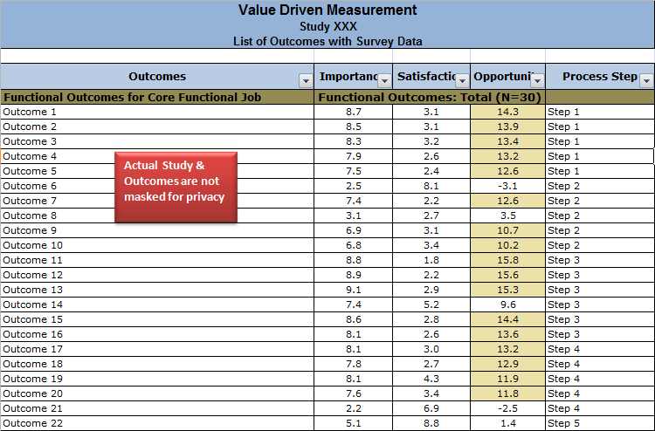
Quantitative Data from Study

Slide 27
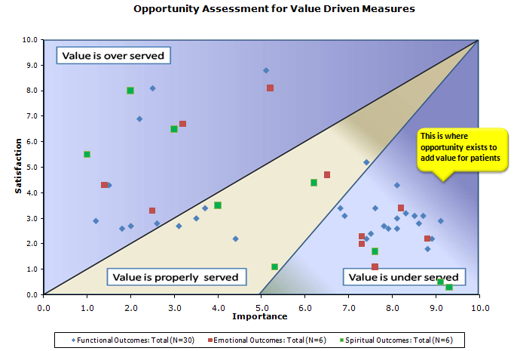
Quantitative Analysis from Study

Slide 28
If you are interested in obtaining more information about our services, please visit us online or contact us directly.
Online: www.enablingvalue.com
Phone: (847) 261-IDEA
Email: jeffrey.wallk@enablingvalue.com

